Slide 1
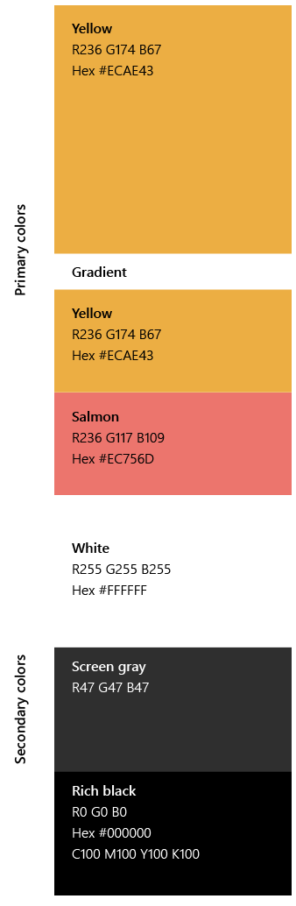


Tech walkthrough
TMR Data Flow

Slide 2
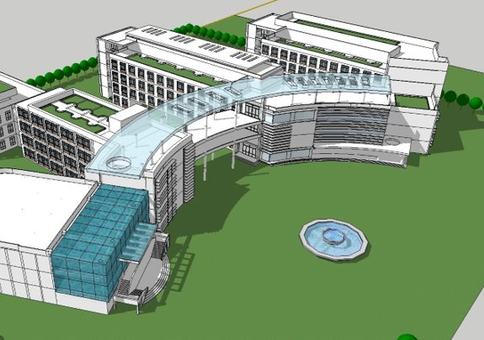
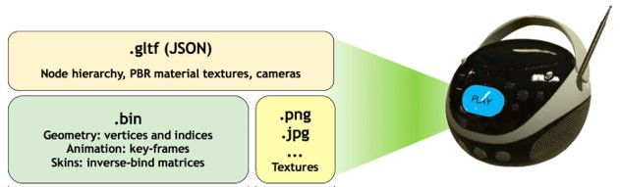



Teams meeting

Slide 3
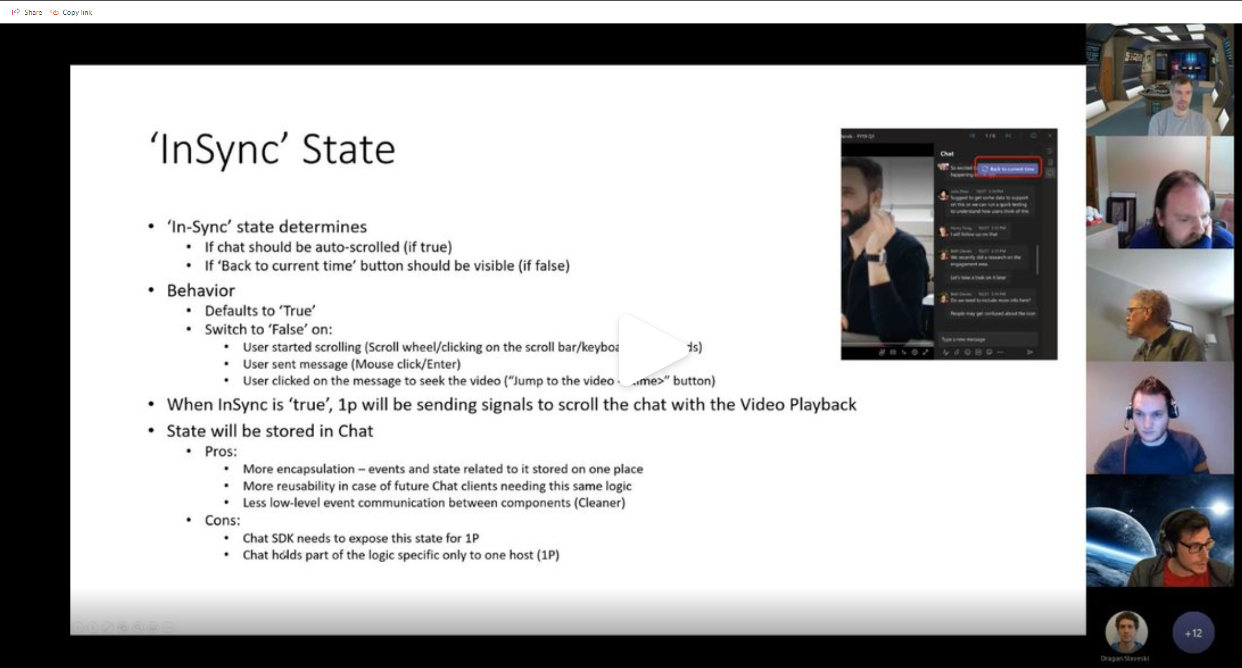
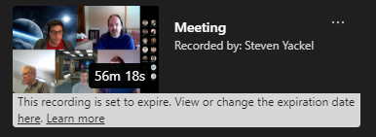
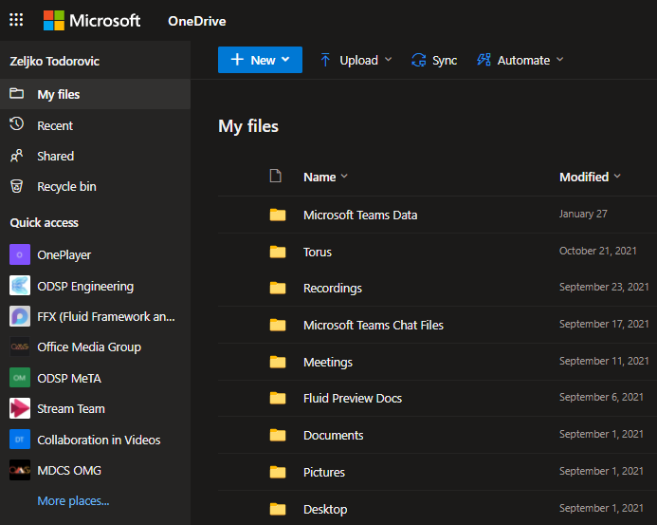
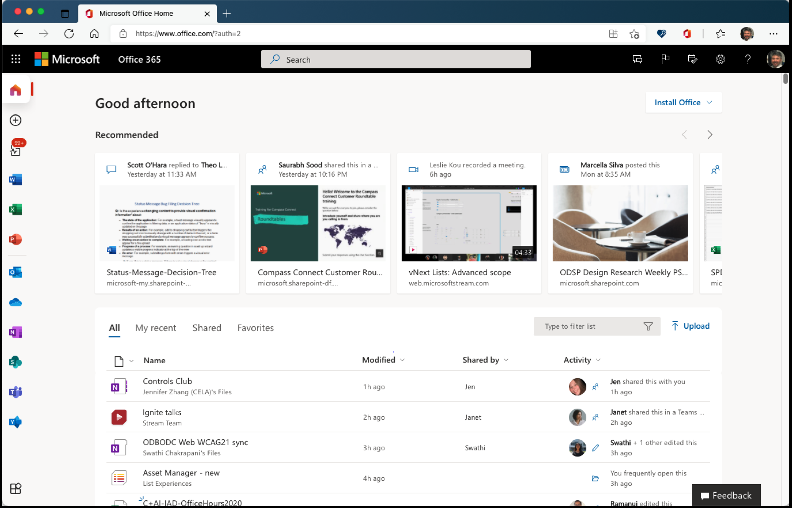
Teams meeting
ODSP

Slide 4

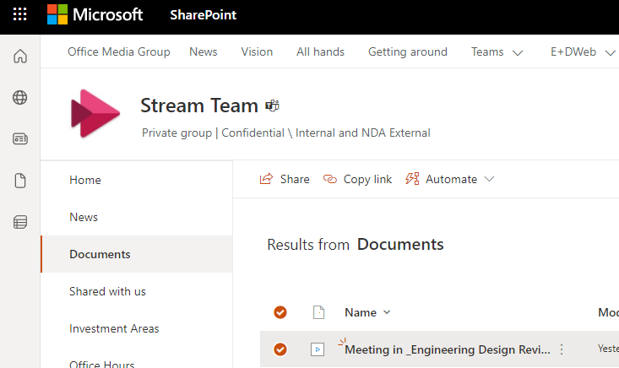


Teams meeting
AMS
ODSP
1P

Slide 5

Call recorder
When you click record, I will join to the call and record media data received from the Media Processor.
Audio data – mixing and distributing
Video data – distributing
ODSP
Audio/video
Media Processor
NG Call Controller
Roster
- Data Modality
Signals
AMS
Composing video
based on modalities
Exporting in chunks
(video fragments)
Establishing call
Managing call state
Who is in the call
Signaling to start recording

Slide 6

Call recorder
Roster
Metadata
Video chunks
PPT Live Events
ODSP
Audio/video
Media Processor
NG Call Controller
Roster
- Modality
Signals
AMS
Composing video
based on modalities
Chat Service

Slide 7

Teams meeting
AMS
ODSP
1P

Slide 8
AMS – Async Media Service
ODSP
Azure Traffic Manager
(Cosmic vs Azure Cloud Service)

Slide 9

AMS – Async Media Service
0-neuqa-123456
index
POST: Create a document: 0-neuqa-123456
frame
PUT: …/0-neuqa-123456/content/mediaframes
index
frame
ODSP

Slide 10
AMS – Async Media Service
0-neuqa-123456
index
POST: Create a document: 0-neuqa-123456
frame
PUT: …/0-neuqa-123456/content/ mediaframes
index
frame
GET: …/0-neuqa-123456/content/video
ODSP
GET: …/0-neuqa-123456/content/spoexport
video

Slide 11
AMS – Async Media Service
ODSP

Slide 12
Teams meeting
AMS
ODSP
1P

Slide 13
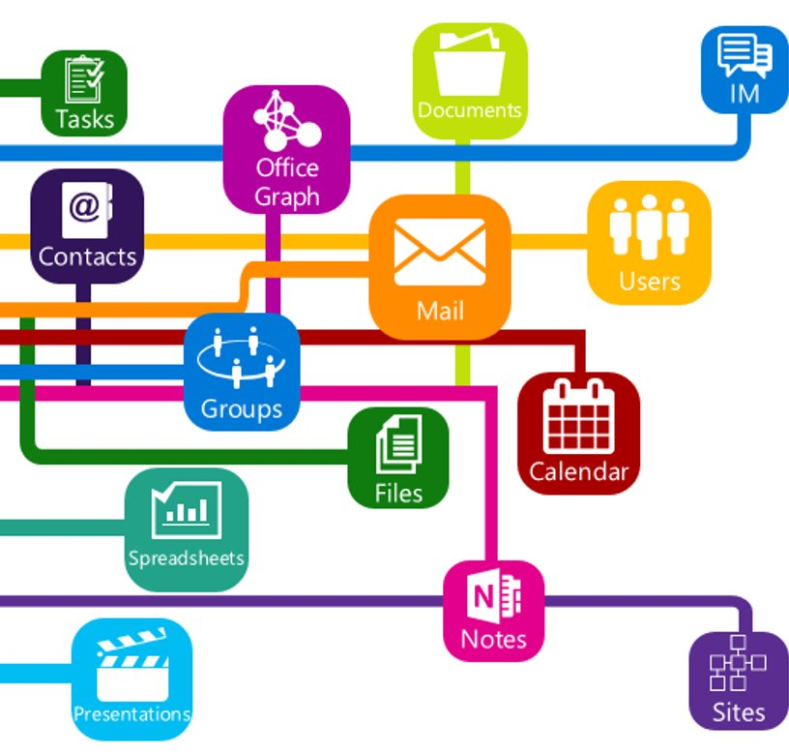

AMT – SPO Export
Stream
MS Graph
ODSP
AAD token
Future
Graph token
SPO token
Transcript
AMT
Chapters
Vroom API

Slide 14

Teams meeting
AMS
ODSP
1P

Slide 15

OnePlayer
MeTA
MeTA
Adaptive
Progressive
Plugins
metadata
ODSP

Slide 16

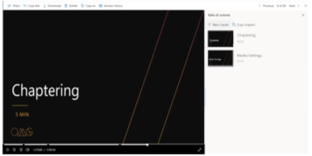




ODSP
PPT Live
Share PPT Live
PPT
PPT
PPT Link
tempauth token
Download
PPT
Upload
Chapters
Start recording
AMD
AMT
New Controller
DocXRay
AMS
MeTA
SAS

Slide 17


